Slide 1
CSTS AGM Agenda 12th June 2019
Apologies for absence
2. Approval of Minutes of previous AGM on 12th June 2019
3. Current financial position Autumn 2020
4. Election of Committee for the session 2020-2021
5. Chair’s report
6. AOB

Slide 2
CSTS AGM 12th June 2019
Apologies for absence: Dr David James, Mr & Mrs Hateley, Mr Conrad Jones, Dr Michael McEllin, Dr Mary Astle, Mr Chris Harmer, Mr Philip Twentyman

Slide 3
CSTS AGM 12th June 2019
2 Approval of Minutes of previous AGM on 13th June 2018
As circulated to all members last month

Slide 4
CSTS AGM 12th November 2020
2018 audited accounts

Slide 5
CSTS AGM 12th June 2019
Current Financial Position June 2019

Slide 6
CSTS AGM 12th June 2019
4. Election of Committee to take office for the session 2019-2020
No nominations have been received from the membership.
The Committee submits the following nominations, all of whom are eligible for election. However, please note the high number of vacancies – current and due.
Chair: Mr John Mulligan (2014) Retiring in 2020
Vice-Chair: Vacant
Committee Secretary: Dr Christopher Wise 2017
IT & Website: Mr Richard Gunner (2016)
Membership Secretary: Mr Andrew Bernard (2018)
Programme Secretary: Dr Malcolm Savidge (2017)
Treasurer: Mr Philip Twentyman (2016) Retiring in 2020
Visits Organiser: Mrs Daphne Morton

Slide 7
Chair’s report 2018-2019
Membership – past 6 years
Lecture attendances & trends
Visits
Current projects
Acknowledgements

Slide 8
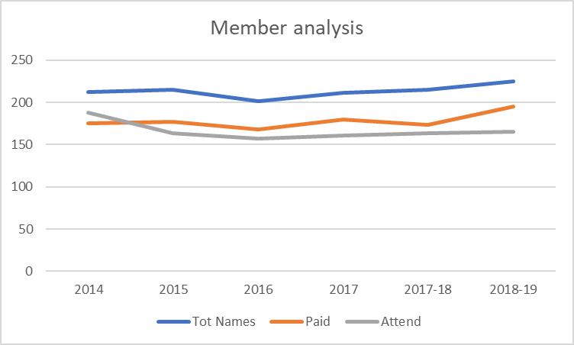
CSTS Membership 2014-2019
Year | Num Names | Num Paid | Num Attend | % Attend
2014 | 212 | 175 | 188 | 89%
2015 | 215 | 177 | 163 | 76%
2016 | 201 | 168 | 157 | 78%
2017 | 211 | 180 | 161 | 76%
2017-18 | 215 | 173 | 163 | 76%
2018-19 | 225 | 195 | 165 | 73%

Slide 9
Lecture attendances in 2018-19
Mth | Subject | Mem | Vis | Tot
Sep | Fiat Lux | 77 | 9 | 86
Oct | Great Western Electrification | 74 | 15 | 89
Nov | Silk | 85 | 12 | 97
Dec | Metals in medicine - Stents | 91 | 7 | 98
Jan | The Rosetta Mission | 95 | 6 | 101
Feb | Handling Wicked Problems | 70 | 7 | 77
Mar | Plants in Today’s Healthcare (with RSC) | 71 | 14 | 85
Apr | Mr Brunel’s Cheltenham Branch (with CAHS) | 87 | 47 | 134
May | Blockchain & Crypto-currencies | 85 | 14 | 99
Jun | Flying & Sailing for a Living
 | AVERAGE | 82 | 15 | 96

Slide 10
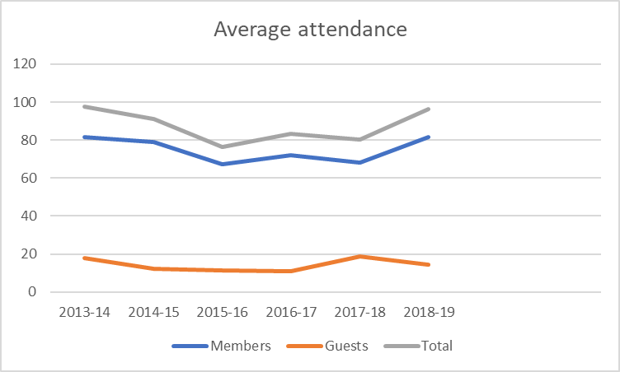
Lecture attendances past 6 years
Year | Members | Guests | Total
2013-14 | 82 | 18 | 98
2014-15 | 79 | 12 | 91
2015-16 | 67 | 11 | 77
2016-17 | 72 | 11 | 83
2017-18 | 68 | 19 | 80
2018-19 | 82 | 15 | 96

Slide 11
Visits 2018-2019
2018
May Jurassic Coast trip from Exmouth
May National Physical Laboratory
June Westmill Wind Farm
October Portsmouth Historic Dockyard
2019
April Lyon Observatory

Slide 12
CSTS Projects and Plans
Expand our existing school grants programme
Widen membership – more younger members
Your views on re-naming to Gloucestershire Science & Technology Society
Occasional less formal debates
Newsletter – Is this of interest to members?

Slide 13
Committee 2018-2019
Chair: Mr John Mulligan (Retiring in 2020)
Vice-chair: Vacant
Committee Secretary: Dr Christopher Wise
Membership Secretary: Mr Andrew Bernard
Programme Secretary: Dr Malcolm Savidge
IT & Website: Mr Richard Gunner
Visits Organiser: Mrs Daphne Morton
Treasurer: Mr Philip Twentyman (Retiring in 2020)

Slide 14
Other helpers 2018-2019
Independent examiner: Mr Tony Gordon
IT & website: Mr Richard Gunner & Dr Mann
Members hospitality: Mrs Jane Gunner & others
Visits organisers: Mrs Daphne Morton
Mrs Chris Stevens

Slide 15
Any Other Business
Any Other Matters to be Raised by Members?

Slide 16
Last but certainly not least
A VERY BIG THANK YOU
TO ALL OUR COMMITTEE MEMBERS & HELPERS

